Slide 1

FMLS Real Estate Outlook
2-12-26

Slide 2
The Economy

Slide 3
The “Wind Chill” Economy
Feels Worse Than It Is
https://youtube.com/shorts/mDLscPRPQv4?si=oxbfHF1d7JQ5OQhH

Slide 4
Consumer Confidence
January Lowest since 2014
Source: Conference Board
Notes:
https://mma.prnewswire.com/media/2592991/RCN_Investor_Sentiment_Survey_Complete_Winter_24_FINAL.pdf?p=pdf
Gallup economic
Confidence Index summarizes Americans assessments jof current economic concditionsIts been negative since 2020.

Slide 5
The economy feels much worse than it is right now. Most Americans agree: this economy stinks. Practically every consumer sentiment survey and political poll points to that theme. There’s only one problem. It’s not true.
David Goldman
Sr Director CNN Business

Slide 6
GDP: 5 Years of Growth
Source: US. Bureau of Economic Analysis
Notes:
https://www.bea.gov/news
GDP Q2 2024 will be released on August 29

Slide 7
Consumer Spending
70% of GDP
Personal Consumption Expenditures, in Billions
Source: BEA
Notes:
https://www.bea.gov/data/consumer-spending/main
The richest 10% of Americans, those earning at least $250,000 a year, account for 50% of all consumer spending, up sharply from 36% thirty years ago.

Slide 8
“The American consumer may be nervous but they are spending like everything is going very very well.
David Goldman
Sr Director CNN Business

Slide 9
Holiday Spending Disappoints
Retail Sales in Billions
Source: Census Bureau, Retail Trade in Billions

Slide 10
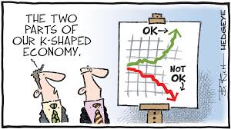

Slide 11
We continue to see a bifurcated consumer base … from lower-income consumers declining nearly double digits in the third quarter, a trend that’s persisted for nearly two years. In contrast, … traffic growth among higher-income consumers remains strong, increasing by nearly double digits in the quarter.
Chris Kempczinski CEO McDonalds
Notes:
Wealth inequality, high prices and low wages are hitting Americans so hard that the bottom of the K is getting priced out of McDonald’s.

Slide 12
Inflation Remains Above 2% Target
Muted Tariff Impact
SERIES: Consumer Price Index
SOURCE: BLS
Notes:
August data 9/11/24
Sept Data !0/10/24
Prices are 20.8% more expensive than they were in February 2020
Why did inflation accelerate so fast?
Pandemic related disruptions
Stimulus Measures
Labor Market tightness
Energy Prices
Monetary Policy
Geopolitical

Slide 13
January Job Growth Is Up!
130,000 New Jobs
Number of Jobs Added by Month
Source: BLS
Notes:
https://data.bls.gov/timeseries/ces0000000001?output_view=net_1mth

Slide 14
Unemployment Rate
Drops to 4.3% in January
Source: BLS
Notes:
https://www.bls.gov/news.release/empsit.nr0.htm
https://www.bls.gov/news.release/empsit.a.htm

Slide 15
“The Spread”: 10 Year Treasury v.
30 Year Mortgage Rate
“risk premium”
10 Year Treasury Bond Yield
Source: Freddie Mac, Dept of the Treasury
Notes:
https://www.freddiemac.com/pmms/pmms_archives

Slide 16
Mortgage Rates? Lowest in 3 Years –
Will the Fed Drive Them Lower?
30-Year Fixed Mortgage Rate
Source: Freddie Mac
Notes:
https://www.freddiemac.com/pmms

Slide 17
Modest Rate Decline Expected in 2026
30-Year Fixed Rate & Projections, as of 1/7/2026
Sources: Freddie Mac, Fannie Mae, MBA, Wells Fargo
Notes:
https://www.fanniemae.com/media/56531/display
https://img03.en25.com/Web/MortgageBankersAssociation/%7B420a7e33-3b04-4d80-8f42-8c9333766f98%7D_Mortgage_Finance_Forecast_Dec_2025.pdf
https://wellsfargo.bluematrix.com/docs/html/88d2eafa-3a64-4cca-b013-4093132d9c99.html

Slide 18
2026 Forecast: 2.0 – 2.4% Growth
Source: US. Bureau of Economic Analysis
Notes:
https://www.bea.gov/news
GDP Q2 2024 will be released on August 29

Slide 19
In the past there has been a strong correlation between falling consumer sentiment and recessions. Since the pandemic this correlation has broken. Will the wind chill across the economy begin to thaw? Or will history repeat itself?

Slide 20
National Housing Market
Overview
(But wait – isn’t my area unique?)

Slide 22
U.S. Existing Home Sales
Forecast 14% Increase in 2026
In Millions, 2019–2026
*
Source: NAR

Slide 23
US Median Sales Price
Forecast 4% Increase in 2026
2019-2026
Source: NAR
Notes:
https://www.realtor.com/research/data/
https://www.realtor.com/research/September-2025-data/

Slide 24
Wage Growth > Home Prices in 2026
Year-Over-Year Change in Median Home Sales Price vs Wages
Source: Redfin
Notes:
https://www.redfin.com/news/housing-market-predictions-2026/

Slide 25
FMLS: Closed Sales
Source: FMLS; SF Detached
Notes:
https://www.realtor.com/research/data/
https://www.realtor.com/research/September-2025-data/

Slide 26
FMLS: Average Sales Price
Source: FMLS; SF Detached
Notes:
https://www.realtor.com/research/data/
https://www.realtor.com/research/September-2025-data/

Slide 27
FMLS: Active Inventory
Source: FMLS; SF Detached
Notes:
https://www.realtor.com/research/data/
https://www.realtor.com/research/September-2025-data/

Slide 28
January 2026

Slide 29
Greater Atlanta: Closed Sales
January -11.3% YOY
Source: FMLS; SF Detached
Notes:
https://www.realtor.com/research/data/
https://www.realtor.com/research/September-2025-data/

Slide 30
Greater Atlanta Homes for Sale
Approaching Pre-Pandemic Levels
January + 6.7% YOY
Source: FMLS; SF Detached
Notes:
https://www.realtor.com/research/data/
https://www.realtor.com/research/September-2025-data/

Slide 31
Greater Atlanta New Listings
Slowing As Selles Adjust Expectations
January +1.6% YOY
Source: FMLS; SF Detached
Notes:
https://www.realtor.com/research/data/
https://www.realtor.com/research/September-2025-data/

Slide 32
Greater Atlanta Days on Market
Homes Are Taking Longer to Sell
January 2019 - 2026
Source: FMLS; SF Detached
Notes:
https://www.realtor.com/research/data/
https://www.realtor.com/research/September-2025-data/

Slide 33
Greater Atlanta Months of Supply
Approaching “Normal”?
January 2019-2026
Source: FMLS; SF Detached
Notes:
https://www.realtor.com/research/data/
https://www.realtor.com/research/September-2025-data/

Slide 34
Greater Atlanta Pending Sales
Slow Start to Q1 2026
January -6.0% YOY
Source: FMLS; SF Detached
Notes:
https://www.realtor.com/research/data/
https://www.realtor.com/research/September-2025-data/

Slide 35
Greater Atlanta Average Sales Price
January +4.0% YOY
Source: FMLS; SF Detached
Notes:
https://www.realtor.com/research/data/
https://www.realtor.com/research/September-2025-data/

Slide 36
Buyer/Seller Dynamics Have Shifted
Number of Active Buyers and Sellers
Source: Redfin
Notes:
https://www.redfin.com/news/sellers-vs-buyers-price-impact/
https://www.resiclubanalytics.com/p/housing-market-now-has-500000-more-home-sellers-than-homebuyers-redfin
Fewer buyers means less competition for home listings and more pressure on sellers to dial back their asking price and make other concessions to help get a deal done. That’s a stark reversal from just a few years ago, when it wasn’t uncommon for homeowners to receive offers well above their asking price from multiple home shoppers.
There is no doubt market power has shifted to buyers. Can it be a buyers market without buyers?

Slide 37
Atlanta: 63% more Sellers Than Buyers
Estimated Number of Buyers and Sellers Active in the Market
# BUYERS
Source: Redfin
Notes:
https://www.redfin.com/news/data-center/
Data is for April 2025

Slide 38
Seller Concessions Are A New Market Reality
U.S.
Source: Redfin
Notes:
https://www.redfin.com/news/data-center/
Data is for April 2025

Slide 39
Affordability
Notes:
https://www.bankrate.com/real-estate/housing-market-2025/#housing-market

Slide 40
Q: What is going on?
More Inventory
Softer Demand
Longer Listings
Flatter prices
A: Un-Affordability

Slide 41
Affordability
Rates
Prices
Wages

Slide 42
Affordability Remains Constrained
Monthly Payment up 32% since 2022
148
NAR Housing Affordability Index
Notes:
https://www.nar.realtor/blogs/economists-outlook/trends-in-housing-affordability-who-can-currently-afford-to-buy-a-home
the American family earns less than the income needed to purchase the median-priced home.
$1765
2025 $ 2326
32% increase in 3 years

Slide 43
Even with more homes on the market, buyer response has remained muted compared to what we’d expect from similar supply shifts in the past.
Danielle Hale
Chief Economist Realtor.com

Slide 44
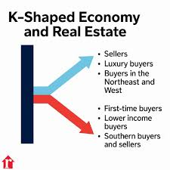
K
K
K

Slide 45
The U.S housing market is split into two groups: first time buyers struggling to enter the market and current homeowners buying with cash.
Jessica Lautz, NAR Deputy Chief Economist
2025 Survey of Home Buyers and Sellers

Slide 46
Share of First-Time Buyers
1981 vs 2025
Source: NAR Survey of Homebuyers and Sellers
Notes:
https://www.realtor.com/research/data/
https://www.realtor.com/research/September-2025-data/

Slide 47
Age of First-Time Buyers
1981 vs 2025
Source: NAR Survey of Homebuyers and Sellers
Notes:
https://www.realtor.com/research/data/
https://www.realtor.com/research/September-2025-data/

Slide 48
Higher cost markets, with higher income buyers, are seeing faster price growth…The growing divide in the housing market is troubling because it is leading to a wider wealth gap.
Lisa Sturtevant Chief Economist Bright MLS

Slide 49
Baby boomers, between 60 and 78, are the largest share of both homebuyers and sellers – moving markets more than younger generations often due to their better financial position.
Jessica Lautz, NAR Deputy Chief Economist
2025 Survey of Home Buyers and Sellers

Slide 50
New Homes: Years of Under-building
Single-Family Housing Units Completed, in Thousands
15+ Years of
Underbuilding
Source: Census
Notes:
www.census.gov/construction/nrc/xls/co_cust.xls
Average: 1,009 2023: 1,002.5

Slide 51
The housing shortage is the biggest economic crisis that no one is talking about. The failure to build enough homes over the last 15 years is driving up rents, worsening inequality and limiting economic mobility.
Mark Zandi Chief Economist
Moody’s Analytics
Notes:
https://themortgagereports.com/115110/real-estate-investor-share-decline

Slide 52
America’s Housing Deficit
Estimates Range from 3.3 to 7.1 million
Cumulative Housing Deficit or Surplus Since 2012, in Thousands
Housing Surplus
Housing Deficit
Sources: Census, Realtor.com
Notes:
https://www.realtor.com/research/us-housing-supply-gap-2025/
https://fred.stlouisfed.org/series/TTLHHM156N
https://www.census.gov/housing/hvs/index.html
https://www.census.gov/construction/nrc/index.html
At a 2024 rate of construction relative to household formations and pent-up demand, it would take 7.5 years to close the housing gap.

Slide 53
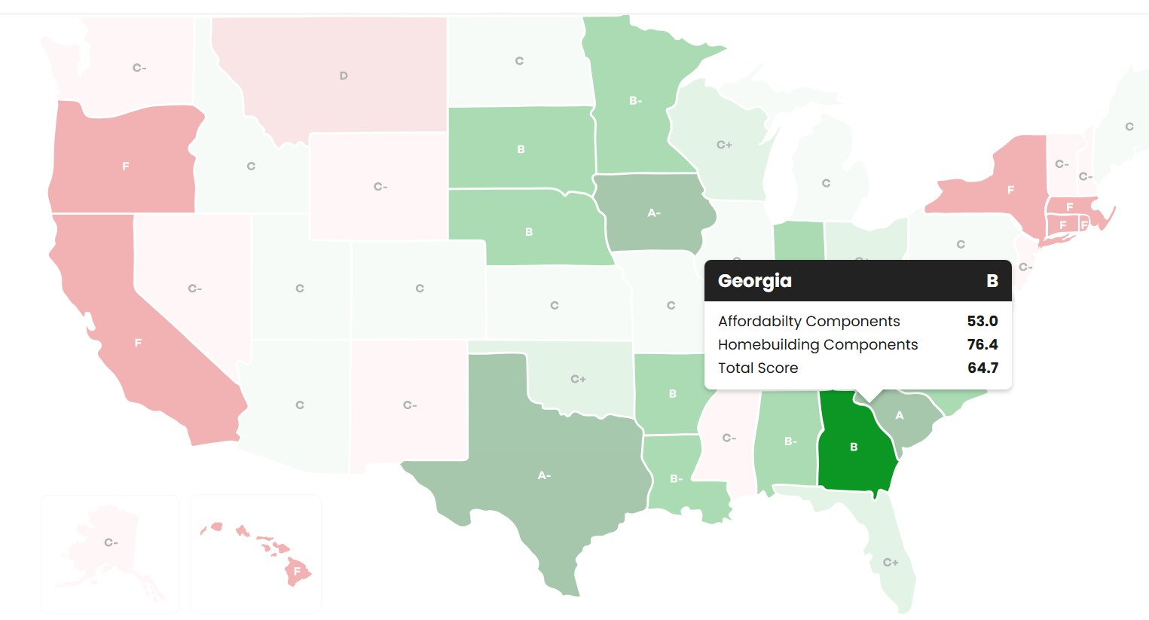
Georgia Gets a Solid “B”
State Report Card
Housing Affordablity & Building

Slide 54
We need more single-family homes, more multi-family homes and more homes for both sale and rent to meet the needs of a younger population.
Robert Dietz
Chief Economist NAHB
Notes:
https://www.investopedia.com/fed-chair-powell-throws-cold-water-on-future-rate-cut-expectations-11839757
The Federal Reserve faces mounting pressure to cut interest rates, with weak consumer spending and inflation stalling near 3%, according to the Beige Book. Analysts now foresee an... See More

Slide 55
Atlanta is a radically different place than it was when the growth spurt began. The city can only continue its accent through reinvention.
Gregory Randall
Georgia Tech

Slide 56
Best Advice for Buyers:
Don’t be discouraged – its getting better
Best Advice for Sellers:
Do the math and price realistically

Slide 57
Thank You
Notes:
https://www.bankrate.com/real-estate/housing-market-2025/#housing-market

