Slide 1


A Tale of Two Markets:
Economic & Housing Market Update
Leslie Appleton Young
Chief Economist FMLS
FMLS Showcase
August 20, 2026

Slide 2
Economy

Slide 3
The Economy: Resilient & Decelerating
Percent Change in GDP, Annualized
Source: Bureau of Economic Analysis
Notes:
https://www.bea.gov/data/gdp/gross-domestic-product
Revised down from 2% from Q1 2026

Slide 4







Slide 5
…in a normal economy these shocks would have bitten harder. They didn’t, because something larger was running underneath them: a gigantic buildup, preparation and surge of business optimism around AI.
Gad Levenson
Chief Economist, Burning Glass Institute
Notes:
https://wellsfargo.bluematrix.com/docs/html/e698efed-2046-4a51-98dc-ed007ec23462.html

Slide 6
AI Dominates Capital Expenditures “CapEx”
$ Billions
Source: BLS

Slide 7
“Hyper-scalers” CapEx:
3x Increase since 2021
$ Billions
Source: Company Earnings Reports
Notes:
Since 2018 data exemption from state and local sales/use tax on equipment purchases – a major draw for site selection centers investing at least $100-$250 million qualify for
Georgia has emerged as a top-four global hub for AI data centers, attracting over $4.5 billion in venture capital and tens of billions in private infrastructure commitments. This massive capital spending drives rapid state economic development and tech expansion, but it heavily strains local electricity grids and raises consumer utility bills

Slide 8
If your chair has fewer legs it’s a lot easier to tip over.
Heather Long Chief Economist
Navy Federal Credit Union

Slide 9
Job Market is Slowing
23K Jobs Lost in July
Number of Jobs Added by Month
Source: BLS
Notes:
https://data.bls.gov/timeseries/ces0000000001?output_view=net_1mth

Slide 10
Inflation Above 2% for FIVE Years
Core Personal Consumption Expenditures (PCE) Price Index
(Percent Change Year-Over-Year, Seasonally Adjusted)
Federal Reserve Target Rate: 2%
Source: BEA
Notes:
https://www.investing.com/economic-calendar/core-pce-price-index-905

Slide 11
I believe that price stability should be a change in prices such that no one’s talking about it.
Kevin Warsh
Chairman
Federal Reserve Board

Slide 12
Probability of Rate Hike this Year
“Steady for Longer” After Soft Jobs Report
Source: CME FedWatch Tool 8/26

Slide 13
We have the capability and commitment to deliver on our price stability objective of 2%. The commitment is strong, unanimous and unambiguous.
Kevin Warsh, Chairman
Federal Reserve Board

Slide 14
What are Investors Thinking?
Check the 10-Year Treasury Yield
Source: Macrotrends
Notes:
https://www.macrotrends.net/2016/10-year-treasury-bond-rate-yield-chart
https://www.freddiemac.com/pmms/pmms_archives

Slide 15
The 10-year Treasury yield matters because it reflects economic expectations, the behavior of financial markets and everyday borrowing costs. It shows how investors perceive inflation, growth and risk over the long term.
Seth Carlson
JP Morgan Wealth Management

Slide 16
30-Year Mortgage Rate Moves With the 10-Year Treasury Yield
Average Spread: 1.76
Sources: Freddie Mac, Macrotrends
Notes:
https://www.macrotrends.net/2016/10-year-treasury-bond-rate-yield-chart
https://www.freddiemac.com/pmms/pmms_archives

Slide 17
Oil Price U-Turn Sends Rates Higher
Sources: EIA, Mortgage News Daily
Notes:
https://www.eia.gov/dnav/pet/hist/LeafHandler.ashx?n=PET&s=RBRTE&f=W
https://www.mortgagenewsdaily.com/mortgage-rates/30-year-fixed

Slide 18
Oil matters, particularly since it drives inflation expectations and thus influences the bond market, from which mortgage rates are set.
Rich Martin
SVP of Retail Lending, Curinos

Slide 19
Mortgage Rates: Elevated
Source: Freddie Mac 30 Year FRM
Notes:
https://www.freddiemac.com/pmms

Slide 20

Notes:
https://www.magnific.com/vectors/k-calligraphy

Slide 21
The top 20% of households account for nearly 2/3 of all U.S. spending. High earners benefit from rising stock markets and high home values.
Mark Zandi, Chief Economist Moody’s

Slide 22
Home Value, Equity, and Debt
$ Trillions
Source: Federal Reserve
Notes:
https://fred.stlouisfed.org/tags/series?t=real+estate
Equity: https://fred.stlouisfed.org/series/OEHRENWBSHNO
Liability: https://fred.stlouisfed.org/series/HNOTMLQ027S
Real Estate Value: https://fred.stlouisfed.org/series/HOOREVLMHMV

Slide 23
Homeowners Are Sitting on
$18 Trillion in Home Equity
2/3 Have
Paid off
Their Mortgage or Have at Least 50% Equity
Mortgage Homes
with More Than 50% Equity
Own the Home
Free and Clear
Mortgage Homes
with Less Than 50% Equity
Source: Census, ATTOM
Notes:
https://data.census.gov/table/ACSDT1Y2022.B25027?q=mortgage
https://www.attomdata.com/news/market-trends/home-sales-prices/q4-2025-home-equity-and-underwater-report/
$11.7 t is tappable; held by 47.5 million mortgage holders
Average tappable equity per borrower is $212K

Slide 24
An increasingly K-shaped economy can’t be good. It means the economy is highly dependent on a small group of the well-to-do, who, in turn, spend based in significant part on how their stock portfolios are performing.
Mark Zandi Chief Economist Moody’s

Slide 25
Signs of Stress: Consumer Confidence Subdued
Source: Conference Board
Notes:
https://mma.prnewswire.com/media/2592991/RCN_Investor_Sentiment_Survey_Complete_Winter_24_FINAL.pdf?p=pdf
Gallup economic
Confidence Index summarizes Americans assessments jof current economic concditionsIts been negative since 2020.

Slide 26
Signs of Stress: Retail Sales Pull Back in July
Source: Census Bureau, Retail Trade in Billions

Slide 27
Struggling Homeowners Prioritizing Mortgage Payments
Percent of Loans That Are 90+ Days Delinquent, by Loan Type
Source: Federal Reserve Bank of New York
Notes:
https://www.newyorkfed.org/microeconomics/hhdc/background.html

Slide 28
Signs of Stress: Mortgage Assistance Queries Rising
Index of People Searching for “Help With Mortgage”
Source: Google Trends
Notes:
https://trends.google.com/explore?q=%22Help%20with%20mortgage&date=all&geo=US

Slide 29
Signs of Stress: HELOC’s Up 45%
Outstanding Balances $ billions
Source: NY Fed Consumer Credit Panel/Equifax

Slide 30
Signs of Stress: Wages No Longer Outpacing Inflation
Year-Over-Year Change in CPI vs. Wages
Source: BLS
Notes:
https://www.redfin.com/news/housing-market-predictions-2026/

Slide 31
Housing

Slide 32
US Existing Home Sales
4 million for the past 4 years
NAR; SAAR Monthly Existing Home Sales
Notes:
https://www.nar.realtor/topics/existing-home-sales
https://www.nar.realtor/sites/default/files/2025-05/ehs-04-2025-overview-2025-05-22.pdf

Slide 33
Price Growth Has Moderated
Change in Home Prices, Year-Over-Year
Source: Case-Shiller
Notes:
https://www.spglobal.com/spdji/en/index-announcements/article/sp-cotality-case-shiller-index-reports-annual-gain-in-november-2025/
https://www.spglobal.com/spdji/en/indices/indicators/sp-cotality-case-shiller-20-city-composite-home-price-nsa-index/#news-research

Slide 34
Inventory Rising for 4 Years
Average Active Inventory
Source: HousingWire Data
Notes:
https://www.housingwire.com/

Slide 35
Affordability Squeezed as Rates Rise
Housing Affordability Index
Source: NAR
Notes:
https://www.nar.realtor/sites/default/files/2026-02/hai-12-2025-housing-affordability-index-2026-02-04.pdf
To interpret the index, a value of 100 means that a family with the median income has exactly enough income to qualify for a mortgage on a median-priced home.
The higher the index, the more affordable homes are.

Slide 36
The U.S housing market is split into two groups: first time buyers struggling to enter the market and current homeowners buying with cash.
Jessica Lautz, NAR Deputy Chief Economist
Survey of Home Buyers and Sellers

Slide 37
Share of First-Time Buyers
1981 vs 2025
Source: NAR Survey of Homebuyers and Sellers
Notes:
https://www.realtor.com/research/data/
https://www.realtor.com/research/September-2025-data/

Slide 38
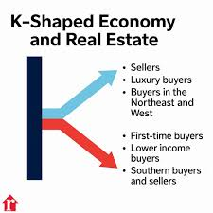
K
K
K

Slide 39
High end buyers are driving demand and prices in much of the country. With wealthy buyers unencumbered and those on tighter budgets struggling to get in the game, the housing story is now a tale of two markets.
Chen Zhao
Head of Economics Research Redfin

Slide 40
Nearly half of all homes priced above $2 million sold without financing —proof that liquidity itself has become the defining edge of the modern housing cycle.
Realtor.com 2025

Slide 41
Atlanta SF Home Sales
July 2019 - 2026
Source: FMLS; SF Detached, Greater Atlanta

Slide 42
Atlanta SF Median Price
July 2019 - 2026
Source: FMLS; SF Detached, Greater Atlanta

Slide 43
Atlanta SF Inventory
July 2019 - 2026
Source: FMLS; SF Detached, Greater Atlanta

Slide 44
Atlanta SF Attached Sales
July 2019 - 2026
Source: FMLS; SF Attached, Greater Atlanta

Slide 45
Atlanta SF Attached Median Price
July 2019 - 2026
Source: FMLS; SF Attached, Greater Atlanta

Slide 46
Atlanta SF Attached Inventory
July 2019 - 2026
Source: FMLS; SFAttached Greater Atlanta

Slide 47
Atlanta SF Luxury Home Sales
July 2019 - 2026
Source: FMLS; SF Detached, Greater Atlanta

Slide 48
Atlanta SF Luxury Median Price
July 2019 - 2026
Source: FMLS; SF Detached, Greater Atlanta

Slide 49
Atlanta SF Luxury Inventory
July 2026
Source: FMLS; SF Detached, Greater Atlanta

Slide 50


Slide 51
Alpharetta SF Home Sales
July 2019 - 2026
Source: FMLS; SF Detached, Alpharetta

Slide 52
Alpharetta SF Median Price
July 2019 – 2026
Source: FMLS; SF Detached, Alpharetta

Slide 53
Alpharetta SF Inventory
July 2019 - 2026
Source: FMLS; SF Detached, Alpharetta

Slide 54
The luxury market’s performance during the first half of 2026 has been shaped by buyer confidence, constrained supply, strategic demand and the enduring appeal of luxury real estate as a long-term investment.
Institute for Luxury Home Marketing
Notes:
https://www.luxuryhomemarketing.com/assets/LMR_NorthAmerica.pdf
The first half of 2026 confirmed that the luxury market continues to chart its own course, as affluent buyers have transacted with confidence despite a more uncertain economic backdrop. The year’s defining story has been the resilience of the luxury buyer. Continued demand from affluent purchasers has sustained sales, supported home values, and increased competition for exceptional properties, even as fewer homeowners chose to bring their homes to market. Although economic uncertainty will continue to influence consumer sentiment, the luxury market enters the second half of 2026 from a position of strength, supported by resilient demand, constrained supply, and buyers who continue to view luxury real estate as both a lifestyle choice and a long-term investment.

Slide 55
New Home Construction
Has Also Plateaued
New Housing Units Started, in Thousands
Source: Census; Sngle family and multi-family
Notes:
https://www.census.gov/construction/nrc/data/series.html
Energy costs make up approximately 4% of residential construction material inpuat and service costs. With newr-term economic risks elevated, 70% of builders reported challenges pricing homes given uncertainty about material costs.

Slide 56
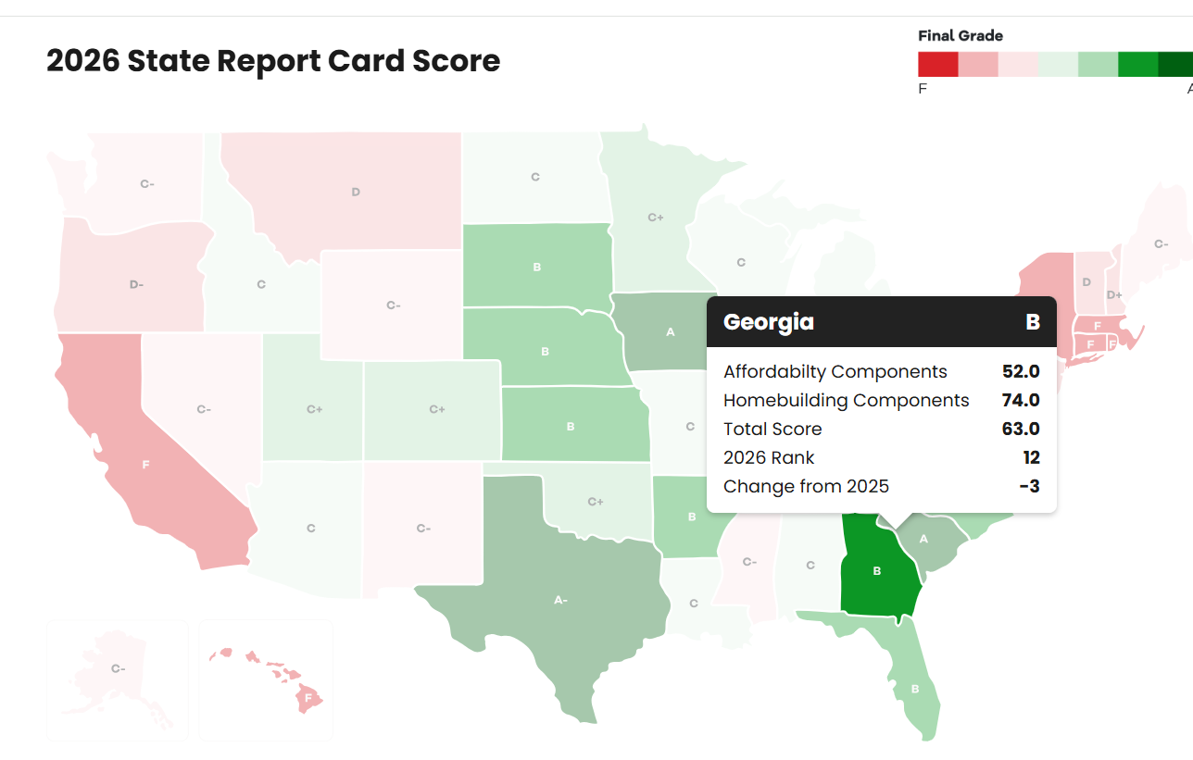
Georgia’s Report Card a Solid “B”
Housing Affordability & Homebuilding
Realtor.com 2026
Notes:
https://www.realtor.com/research/state-report-cards-2026/

Slide 57
Forecast

Slide 58
NAR Revised Housing Forecast: Slower Sales, Steady Prices
 | Previous 2026 Forecast (November 2025) | Current 2026 Forecast
Existing Home Sales | +14% | +4%
New Home Sales | +5% | +0%
Median Home Price | +4% | +4%
Mortgage Rate | 6.0% | 6.5%
Net Job Gains | 800,000 | 400,000
Unemployment Rate | 4.6% | 4.5%
Source: NAR
Notes:
https://www.nar.realtor/sites/default/files/2026-04/forecast-04-2026-us-economic-outlook-04-13-2026.pdf
https://www.nar.realtor/magazine/real-estate-news/economy/housing-market-set-for-a-2026-comeback-nar-predicts
Nearly half of U.S. home sellers gave concessions to buyers in May, the highest May share in our records. . . 16% of May’s home sales had both a concession and a price drop, also the highest May share on record.

Slide 59
Mortgage Rate Forecasts
See Little Change
30-Year Fixed Mortgage Rate and Rate Projections, as of 7/30/2026
Sources: Freddie Mac, Fannie Mae, MBA, Wells Fargo
Notes:
https://www.fanniemae.com/media/57196/display
https://img03.en25.com/Web/MortgageBankersAssociation/%7B4f11b8e3-60bb-4182-841c-0d3754aa329b%7D_Mortgage_Finance_Forecast_Jul_2026.pdf
https://externalcontent.blob.core.windows.net/pdfs/pdfs/WellsFargo07162026.pdf

Slide 60
While Buyers Remain Hopeful
4 in 10 buyers think rates will drop below 5% this year.
Foresee a Spike to 7% or Higher
Believe Rates Will Average Between 5% and 7% This Year
Predict Average Mortgage Rates Will Drop Under 5%
Sources: Best Interest Financial, Clever Real Estate
Notes:
https://nationalmortgageprofessional.com/news/most-buyers-waiting-rates-drop-below-6

Slide 61
Take Aways
1. Buyers waiting for lower rates will be waiting a long time
2. Sellers are listing at the fastest summer pace since 2022
3. Buyers have the upper hand in more markets: seller concessions at historic high
4. Big investors are pulling back; selling more than they are buying

Slide 62
You have no idea what’s going to happen in your life. You never know what is going to happen the day after tomorrow. That’s why you have to live in the moment.
Erling Haaland
IYKYK

Slide 63
Thank-you

